Slide 1
Healthcare Analytics
Group-1

Slide 2
:Group Members: Poonam Amol Mathane Sumit Kumar Das Madathala Satya Raj Gunisetty Harshitha Arpita Hiremath Aditya Bipin Raval Richa Mishra

Slide 3




Agenda
INTRODUCTION
INTRODUCTION
DATA TRANSFORMATION
KPI’s
DASHBOARD’s
CHALLENGES
CHALLENGES
CONCLUSION

Slide 4
Introduction
In the realm of this healthcare analysis project, we will explore:
Patient volumes across summaries
Compare profit and non-profit statistics
Assess chain organizations' performance relative to total scores
Examine dialysis stations' statistics
Analyze category text as expected
Calculate the average payment reduction rate
Through data-driven insights, we aim to understand healthcare dynamics, identify areas for improvement, and optimize the outcomes.

Slide 5
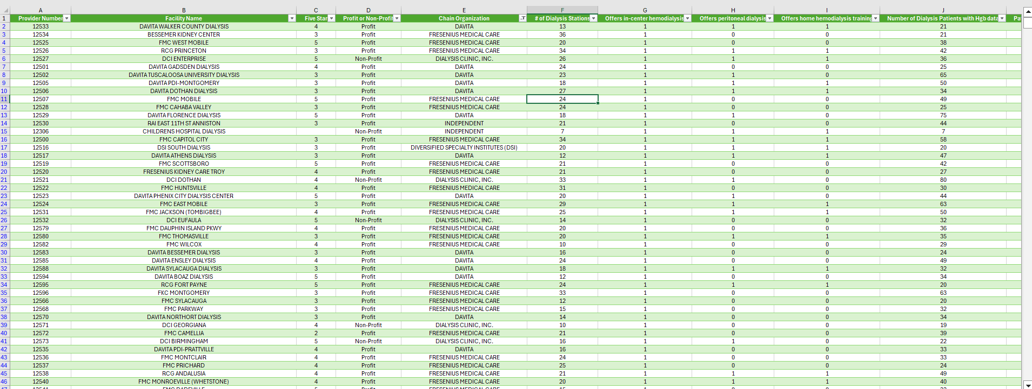
DATA TRANSFORMATION

Slide 6
Healthcare Analysis KPI-1
KPI 1 : Number of Patients across various summaries
Observations : Highest No of patients in Survival Summary (1,938K)
Lowest No of patients in nPCR Summary (980)
Reasons :
From the above observations, we conclude that maximum dialysis patients are taking protein-rich diet which helps to increase survival time.

Slide 7
Healthcare Analysis KPI-2
KPI 2 : Profit Vs Non-Profit Stats
Observations :
Profit facilities/organizations have the highest no of dialysis stations and
offer different dialysis services.
Non-profit facilities/organizations have the lowest no of dialysis stations and offer different dialysis services.
Reasons :
Maintenance of facilities/organizations is a gigantic task that deals with money.

Slide 8
Healthcare Analysis KPI-3
KPI 3 :Chain Organizations w.r.t. Total Performance Score as No Score
Observations :
Highest no of patients (6,818) in the Hospitalization category treatment is
taking place as expected.
The lowest no of patients (3,623) in SWR category treatment is taking place
as expected.
Reasons :
SWR (standardized first kidney transplant waitlist ratio) is less because the number of donors available is less and failure of kidney transplant operations.

Slide 9
Healthcare Analysis KPI-4
KPI 4 :Dialysis Stations Stats
Observations :
DaVita organization has the highest number of dialysis stations,
i.e. 50,140.
Satellite Healthcare Inc. has the highest number of dialysis stations,
i.e. 690.
Reasons :
DaVita organization is a profit organization.
Satellite Healthcare Inc. is a non-profit organization.

Slide 10
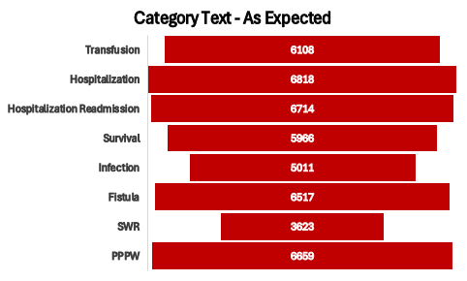
Healthcare Analysis KPI-5
KPI 5 :# of Category Text - As Expected
Observations :
DaVita has the highest number of dialysis stations with performance
scores as Zero, i.e. 119.
Fresenius Medical Care has the 2nd highest number of dialysis stations with
performance score as Zero, i.e. 118.
Reasons :
Poor quality service, High Service cost, etc.

Slide 11
Healthcare Analysis KPI-6
KPI 6 : Average Payment Reduction Rate
Observations :
The highest average payment reduction is given by the organizations which are
having least no of dialysis stations.
The lowest average payment reduction is given by the organizations which are
having more no of dialysis stations.
Reasons :
Organizational Competence, Business strategy, etc.

Slide 12
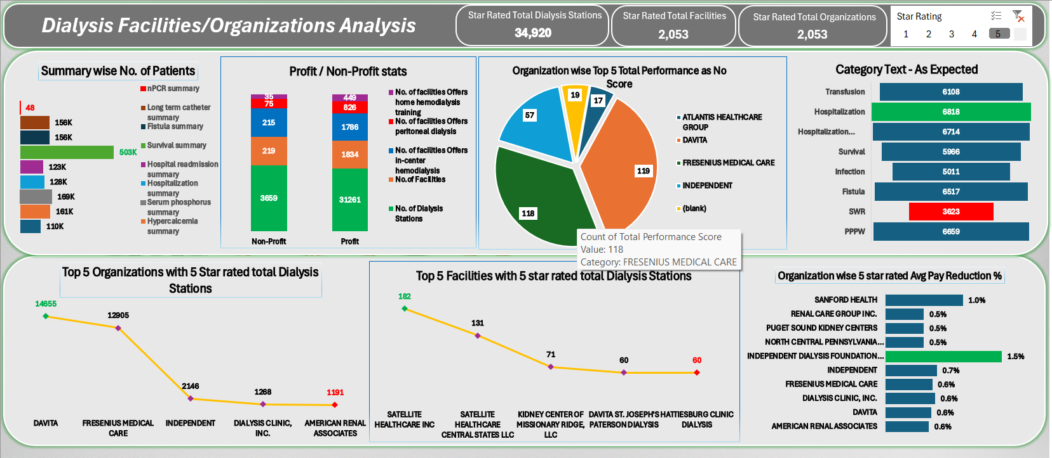
EXCEL Dashboard

Slide 13
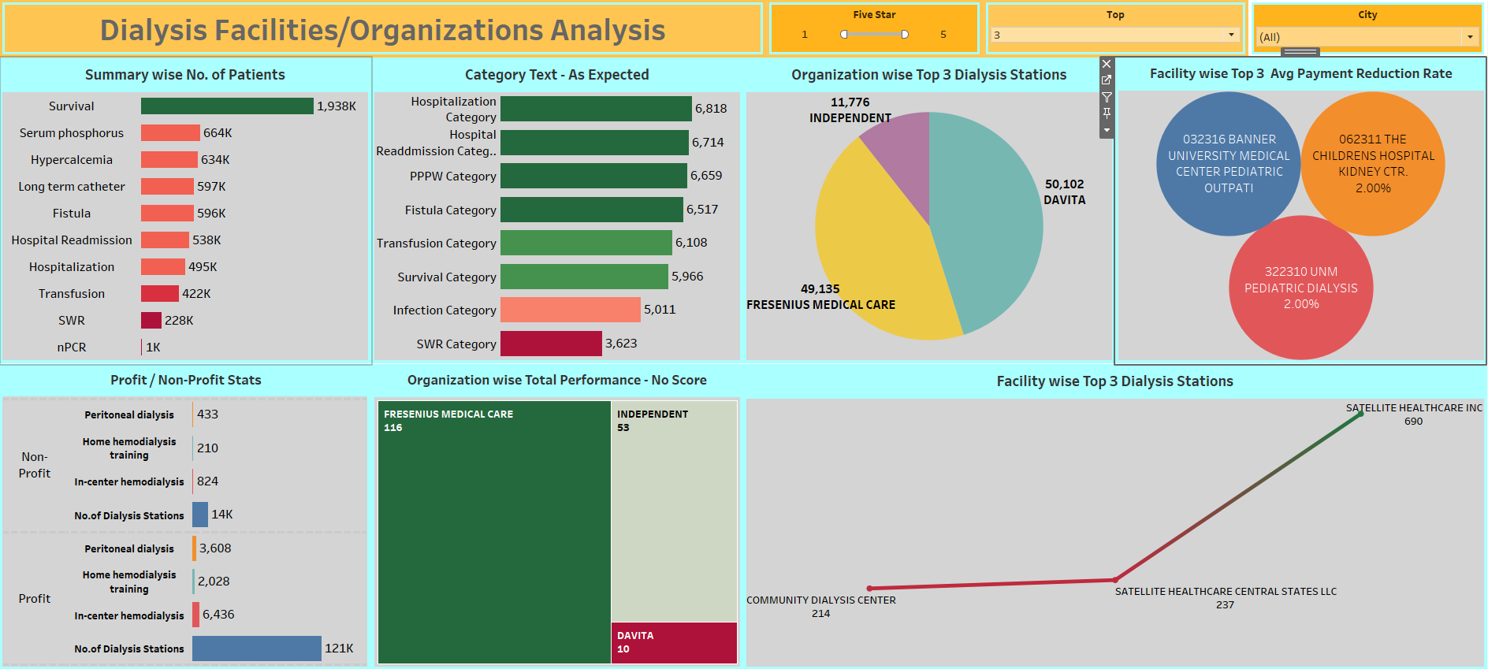
TABLEAU Dashboard

Slide 14
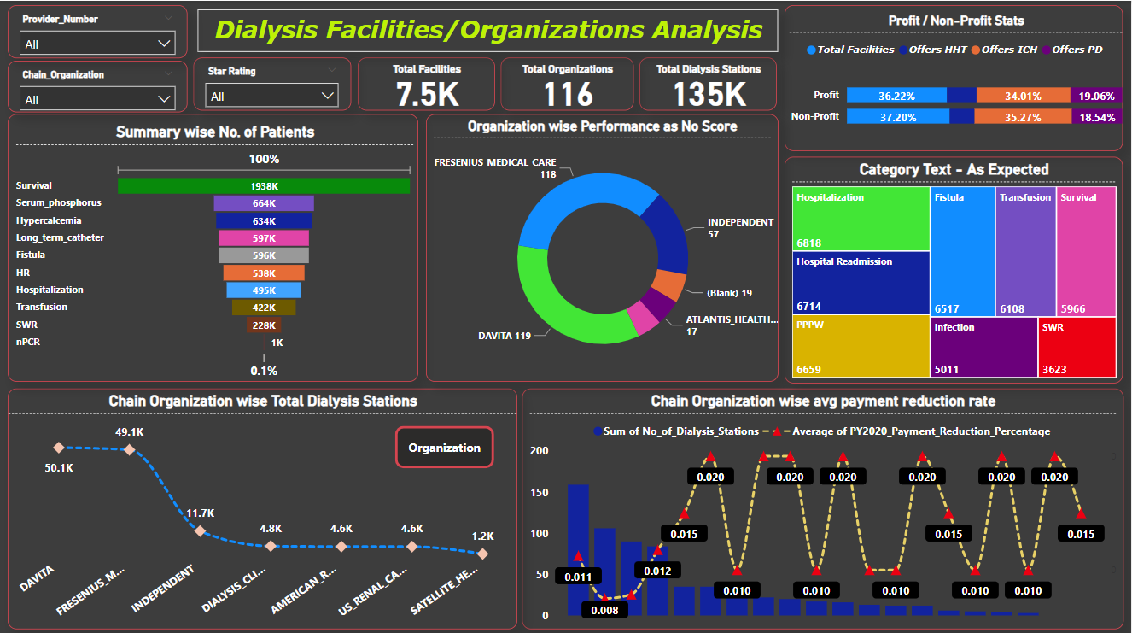
POWER-BI Dashboard

Slide 15

Challenges
Dealing with Date column understanding, Data Cleaning, and Proper Arrangement of columns according to their necessity in data in Excel.
Understanding the Medical Terminologies (Domain Knowledge) in Data
Merging Two Datasets with different Column names.

Slide 16

Insights
Healthcare Analysis
01
02
03
04
05
06
Profit Facilities and dialysis stations
Non - profit Facilities and dialysis stations
Organisational Accountability
Service Quality
Survival Summary Dominance
Resource allocation and Specialisation
Diverse Healthcare Needs
Resource Allocation Considerations
Market Dynamics
Patient access and care quality
Strategic Positioning
Financial Dynamics

Slide 17

Thank You!

